Slide 1

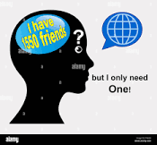
Social media and Loneliness
I/O Psychology

Slide 2
Group members
Anuradha Das Group (2001CB10)
Shambhavi (2001EE64)
Ritu Saini (2001CE50)
Sweta Kumari (2001CB57)
Shashi Ranjan Kumar (2001ME67)
Pritam Raj (2001ME52)

Slide 3
Table of contents
01
02
03
04
Dataset
Survey Description
Survey Results
Analysis on Results

Slide 4
What is meant by loneliness and Social media addiction ?

Slide 5
Why is there a need for scientific or psychological study for relationship between loneliness and social media?

Slide 6
DATASET

Slide 7
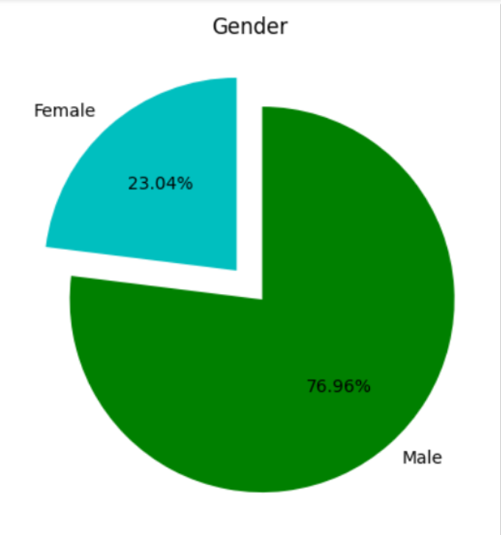
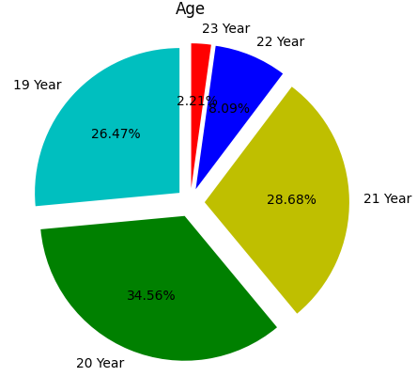
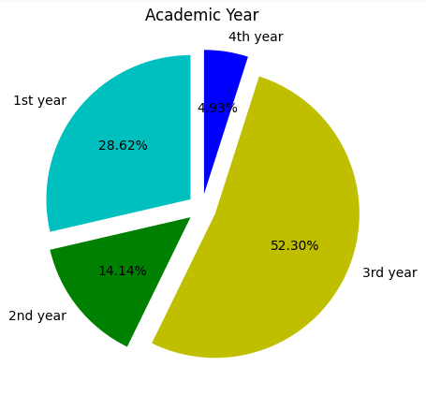
Dataset at a glance
We conducted our survey on 329 participants out of which:
76.96% are males while 23.04% are females.
26.47% are 19-years old, 34.56% are 20-years old, 28.68% are 21-years old, 8.09% are 22-years old and 2.21% are 23-years old.
28.62% belong to 1st year, 14.14% belong to 2nd year, 52.30% belong to 3rd year, 4.93% belong to 4th year.

Slide 8
Survey Description

Slide 9
Survey Form
Our survey form consisted of 2 sections.
Section 1
Section 2
In first section, we put some self designed questions to get an estimate of the level of addiction that students had.
In second section, we put two standard tests taken from internet. One for measuring Social media addiction and other for measuring loneliness.
We used both the tests (our self designed one and standard one) to find the relationship between students’ social media addiction and their loneliness levels.

Slide 10
Survey Questions:
In first section we asked about:
Average time spent by them on social media.
What they prefer doing in their free time?
Percentage of online friends they knew personally.
Do they feel the level of social support available on social media is more than in-person interactions?
Do they feel social media provides a space to express themselves and connect with others who share similar interests and beliefs?
Can they limit their social media use? If yes, then how much they would like to limit?
Did they enjoy using social media more than talking to friends?
For sharing something whom they preferred to talk, online friends or offline friends?
After seeing other people’s post, do they get motivated or nervous?
Do they worry about their popularity online?
Year when they joined social media.
Are You introvert or extrovert?
Did Covid-19 boosted their social media usage?

Slide 11
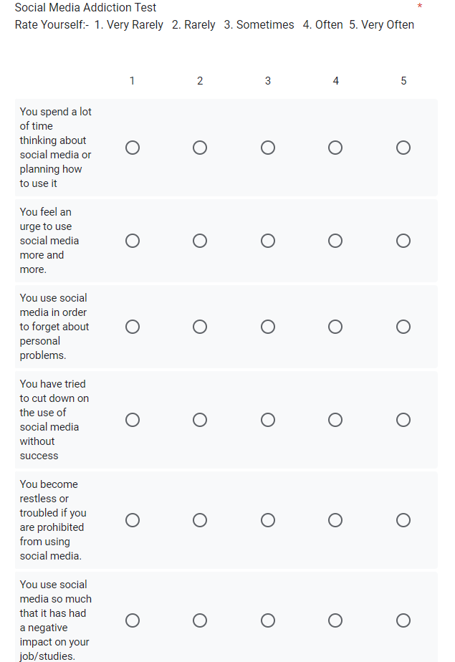
Social Media Addiction Scale(SMAS)
This test is originally called as Bergen Social media Addiction test. In this test, 6 questions are asked, each having score from 1 to 5. Here, score 1 denotes Very rarely, score 2 denotes rarely, score 3 denotes sometimes, score 4 denotes often and score 5 denotes very often.
Score calculation:
If 4 out of 6 questions has 4 or more than 4 score, then the student is addicted to social media.
Total score of the test = 6*5 = 30
If score>20 : extremely addicted
If score lies between 14 to 20 : moderately addicted
If score<14 : not addicted

Slide 12
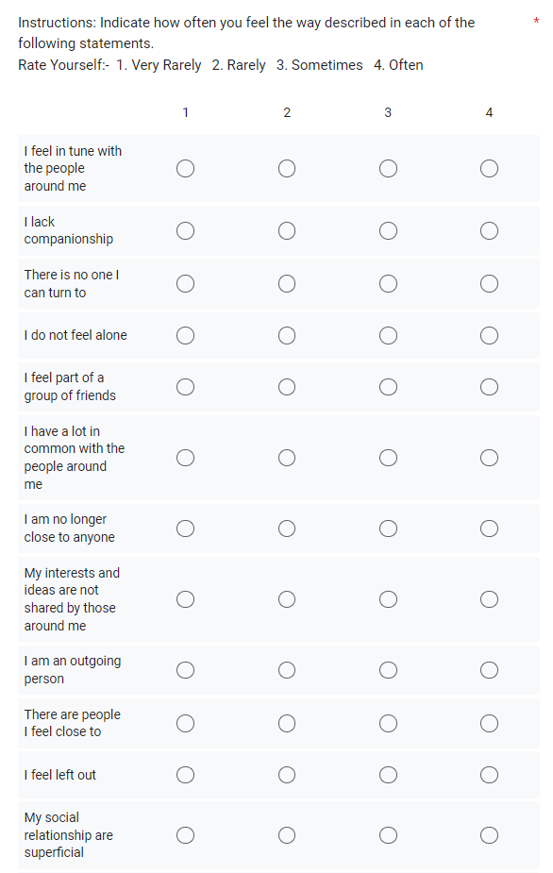
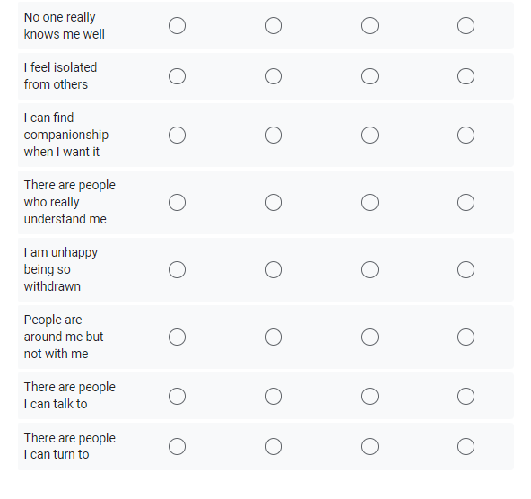
Loneliness Test
This test is originally called as Loneliness measurement scale. In this test, 20 questions are asked, each having score from 1 to 4. Here, score 1 denotes Very rarely, score 2 denotes rarely, score 3 denotes sometimes and score 4 denotes often.
Score calculation:
Total score of the test = 20*4 = 80
If score lies between 61 to 80 : highly lonely
If score lies between 45 to 60 : mildly lonely
If score<45 : not lonely

Slide 13
Survey Results

Slide 14
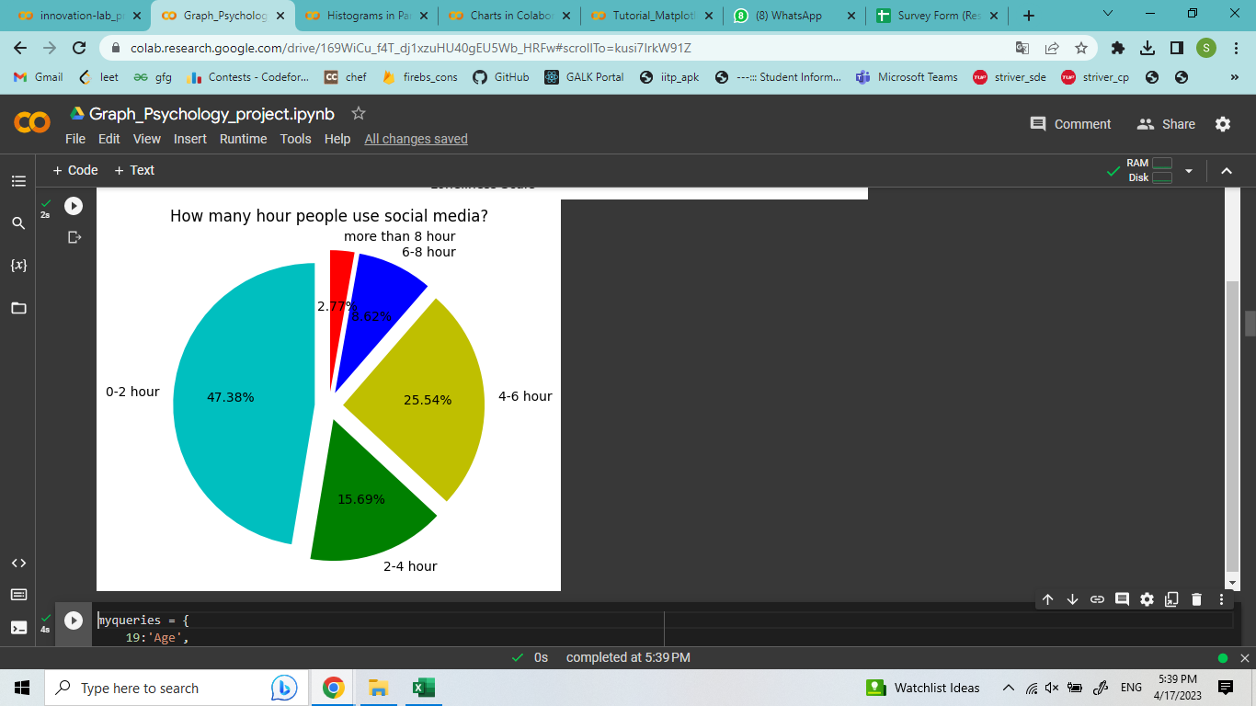
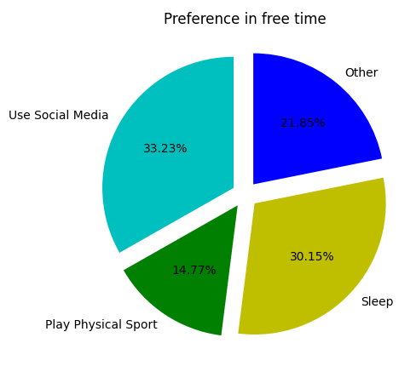
How much time people spend on social media?
What people do, in their free time?

Slide 15
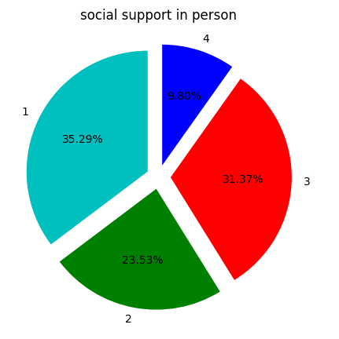
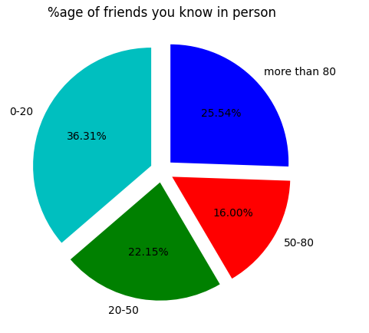
How they feel about the level of social support available on social media vs in-person interactions?
What percent of online friends do people know personally?

Slide 16
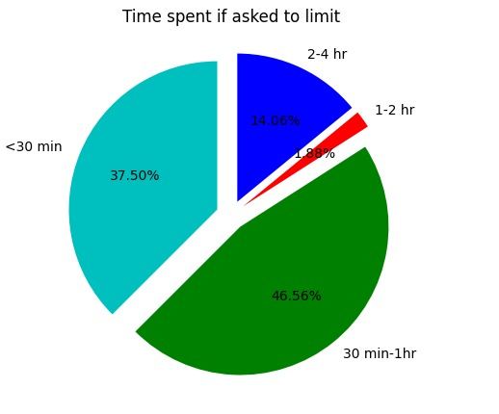
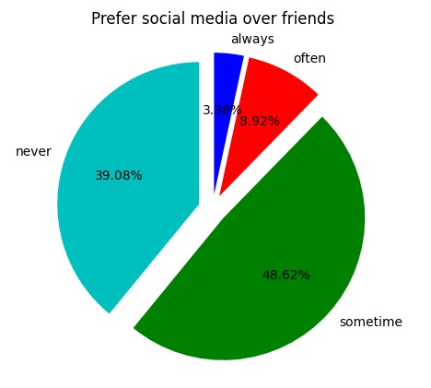
If they are asked to limit social media, how many hours in a day will they use?
Do students enjoy using social media more than talking to friends?

Slide 17
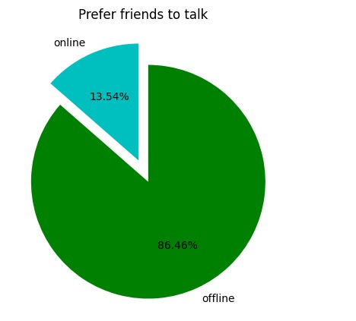
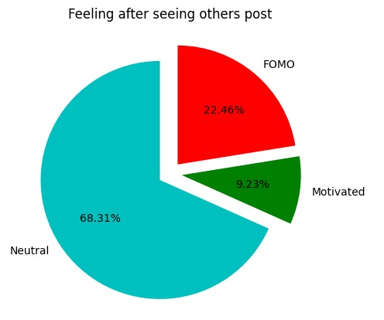
For sharing something, they prefer to talk to online friends or offline friends?
What they feel after seeing other people’s post?

Slide 18
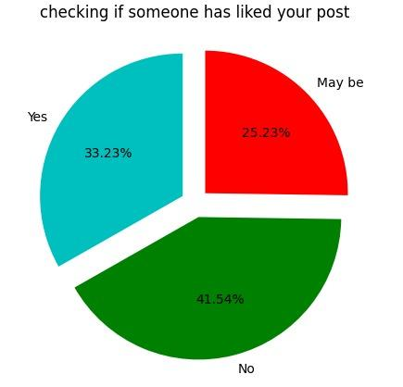
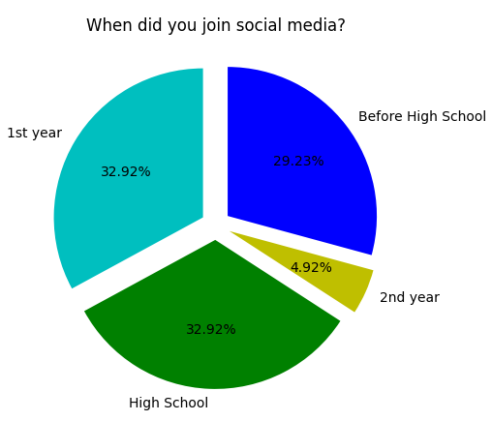
Time of joining social media first time.
Do people worry about checking if people have “liked” their post or wished a "happy birthday"?

Slide 19
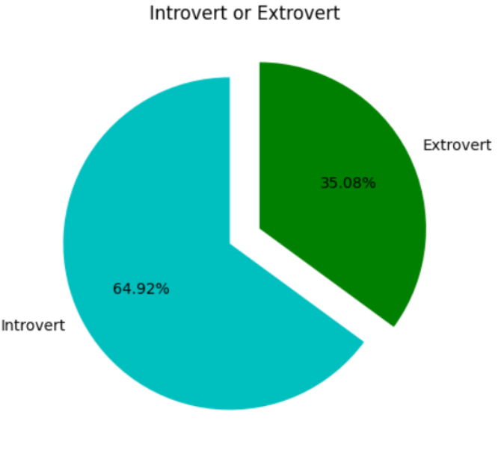
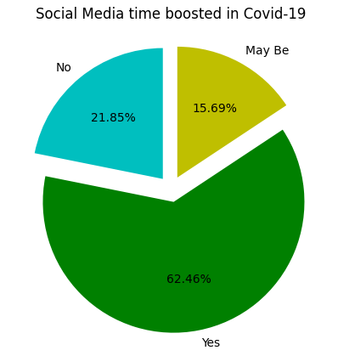
Percentage of introvert and extrovert people.
People opinion about their social media usage boosting during Covid-19.

Slide 20
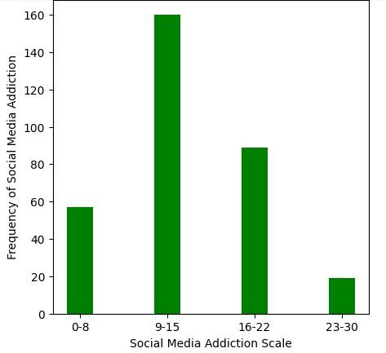
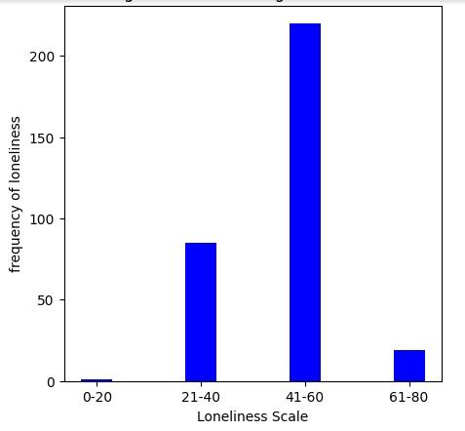
Frequency of social media addiction vs social media addiction scale:
Frequency of loneliness vs loneliness scale:

Slide 21
Survey Analysis

Slide 22
Survey Analysis
Based on section A and LF

Slide 23
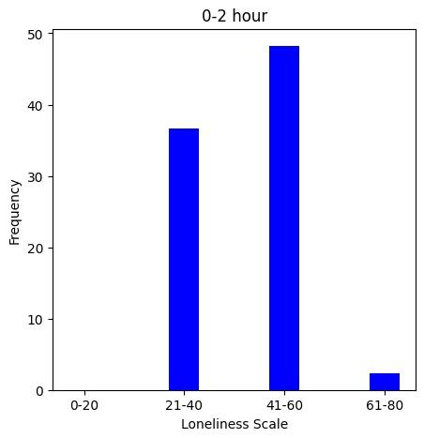
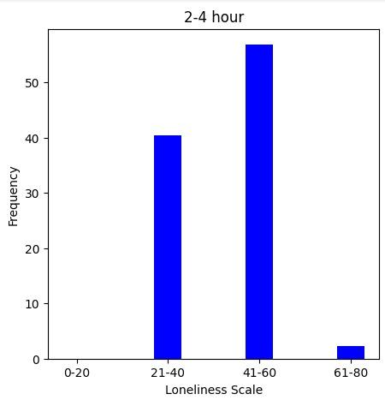
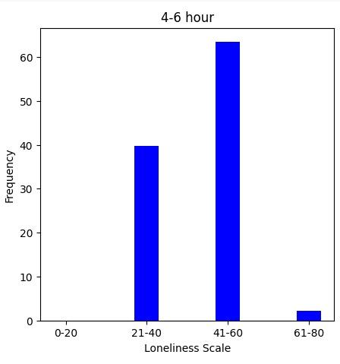
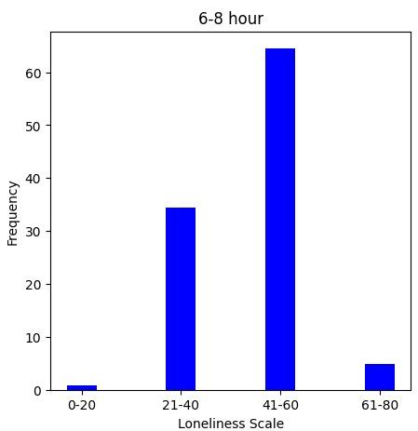
Trend of LF upon daily uses of social media
0-2 hours
2-4 hours
4-6 hours
6-8 hours
People using social media for a long time on a daily basis are found to be more lonely.

Slide 24
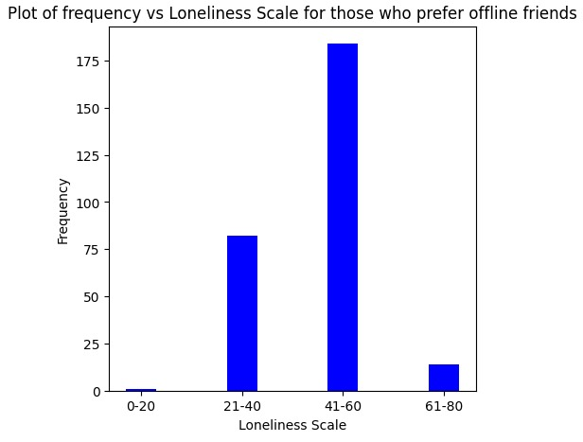
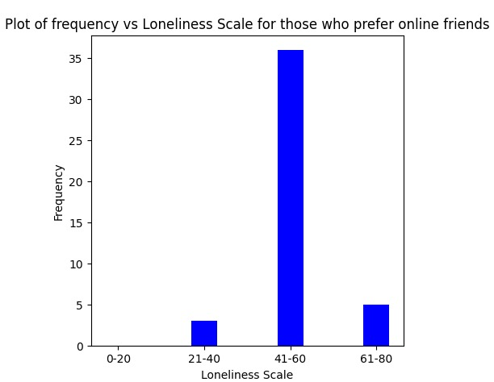
Trend of LF on the basis of preference of online/ offline friends
Online friends
Offline friends
We find that the LF results are higher for people who prefer Online friends in comparison to offline friends.

Slide 25
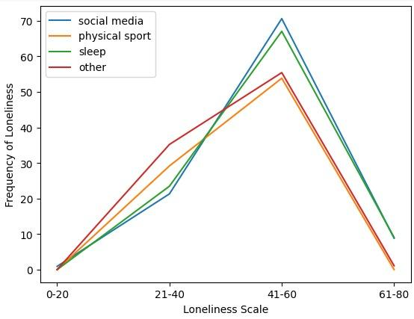
Trend of LF on the basis of what people prefer in their free time
People who prefer Social media in their free time as compared to physical sports, sleep or any other thing, have a higher frequency of the loneliness factor.

Slide 26
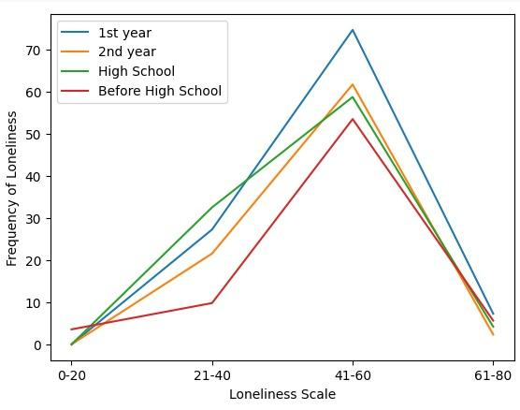
Trend of LF on the basis of currently studying year
1st year students have a higher frequency of loneliness than any other year’s student.

Slide 27
Survey Analysis
Based on section A and SMAS

Slide 28
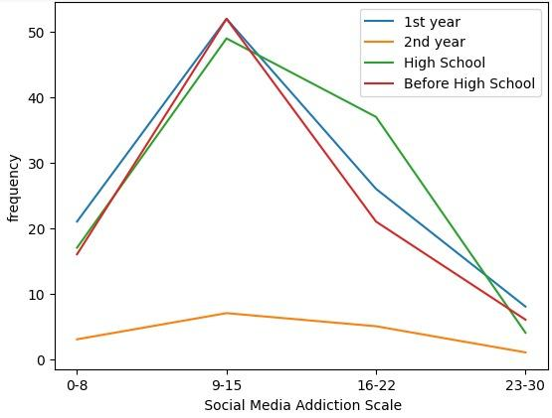
Trend of SMAS on, when an individual joined social media
We found that people who joined social media in High school or 1st year are more lonely as compared to others.

Slide 29
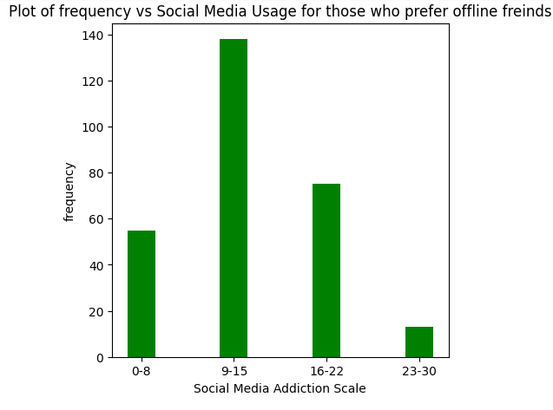
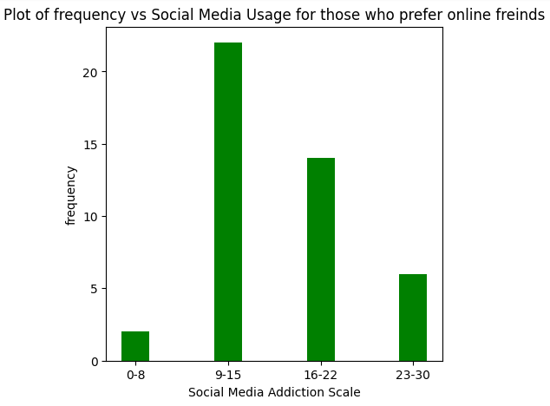
Trend of SMAS on the basis of preference of online/ offline friends
Online friends
Offline friends
We find that the SMAS result are higher for people who prefer Online friends in comparison to Offline friends.

Slide 30
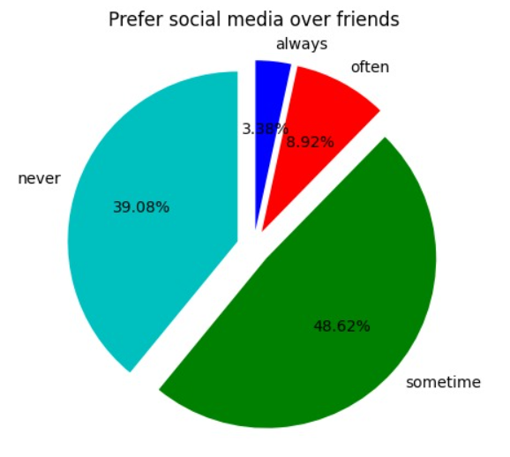
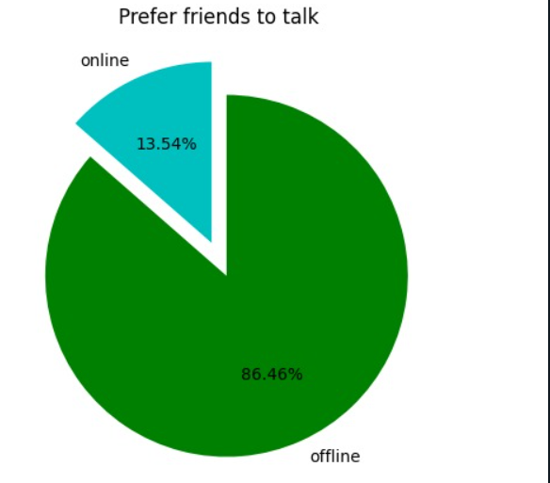
Offline friends/ Online friends
From our survey we got to see that people prefer to talk to offline friends over online friends.
But still, people prefer social media over offline friends.
So, from these two pie charts we can see that trust of college students are more on offline friends but using social media has become desirable for them.

Slide 31
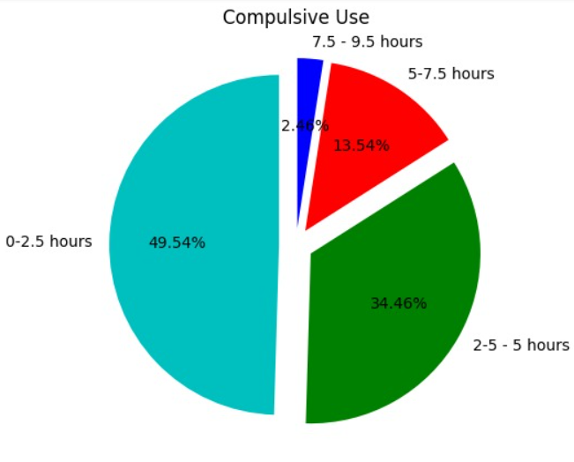
Pie chart showing the compulsive use from our survey:
Difference b/w No. of hours used and no. of hours want to use
More than 50% people yet use 2.5 hours to 9.5 hours.
This shows that even after trying to control social media usage people are unable to do so.

Slide 32
Survey Analysis
Based on section A, LF and SMAS

Slide 33
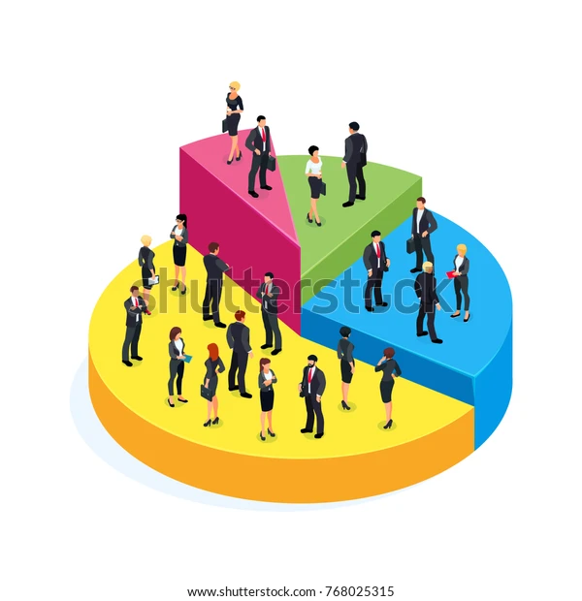
How do loneliness and social media usage have different impact on different demographic groups?
Gender
Age
Academic Year

Slide 34
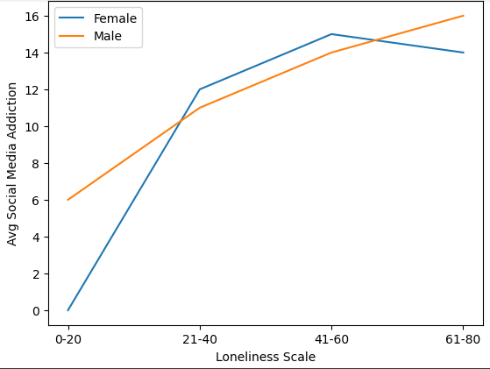
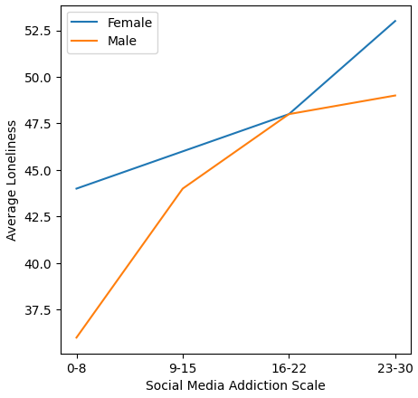
Gender
For both Males and Females, more lonely people are more addicted as compared to less lonely.
There is an increasing trend between social media addiction and loneliness.
Females are more addicted to social media as well as they are more lonely as compared to males.

Slide 35
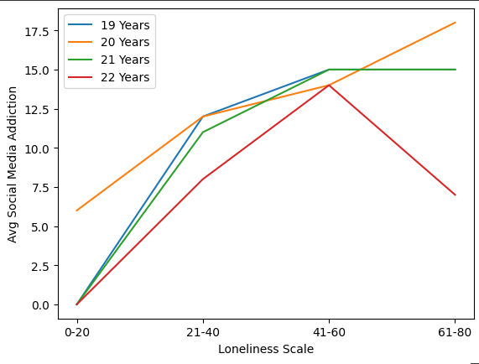
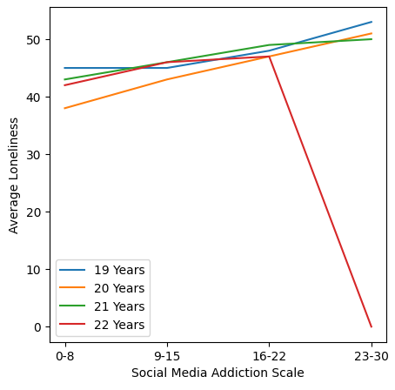
Age
For all age groups, more lonely people are more addicted as compared to less lonely.
There is an increasing trend between social media addiction and loneliness.
19 years old college students are found to be more addicted to social media while 22 years old are least addicted to social media, even though they all were moderately lonely.

Slide 36
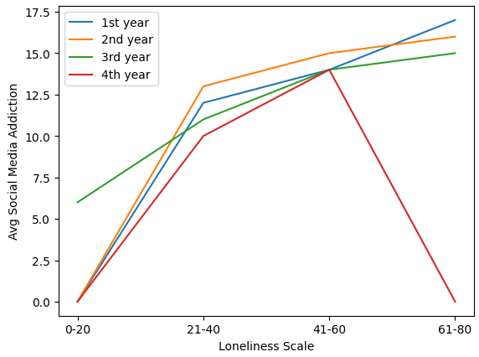
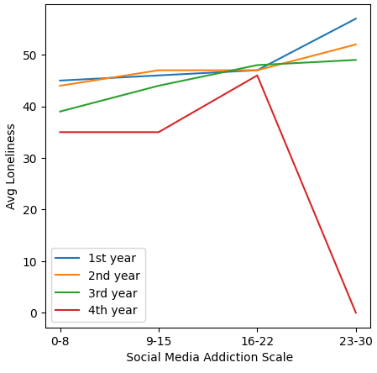
Academic Year
For all academic years, more lonely people are more addicted as compared to less lonely.
There is a increasing trend between social media addiction and loneliness.
1st year and 2nd year is found to be more addicted to social media as well as more lonely while 4th year is found to be least addicted to social media and least lonely..

Slide 37
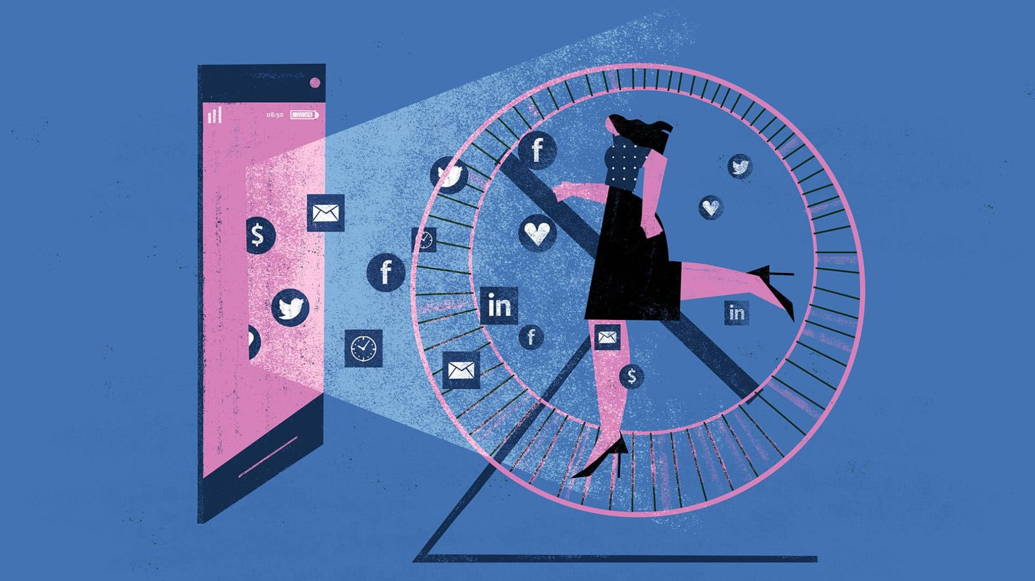
Does the span of time one spends on social media have influence on their level of loneliness?
Daily usage time
Point of initiation
of social media usage

Slide 38
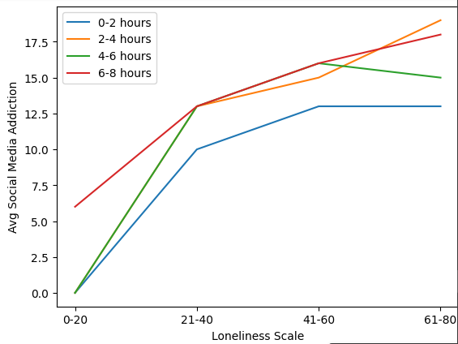
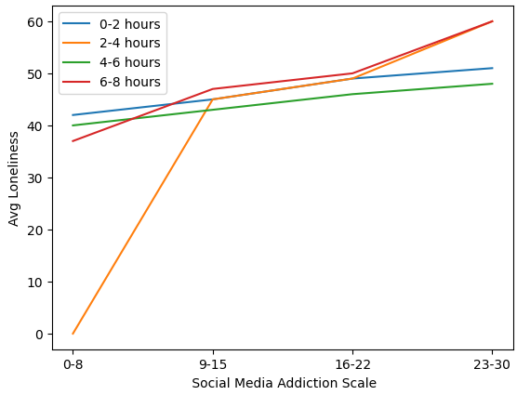
Daily usage time
Loneliness and social media addiction increases as social media usage time increases.
People spending more time on social media are found to be more addicted to social media as well as they are more lonely.

Slide 39
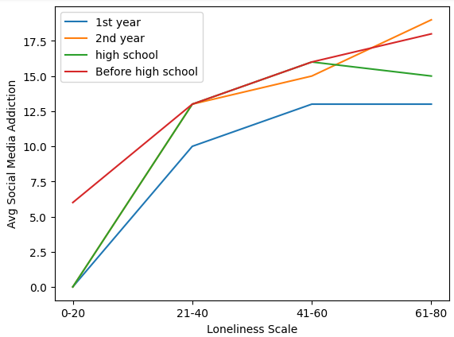
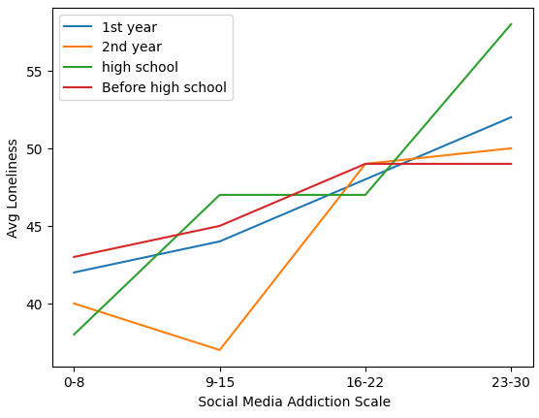
Point of initiation of social media usage
Students who joined social media at early stage, in high school or before high school are found to be more addicted to social media and also they are highly lonely as compared to students who joined social media late i.e, in 1st year or 2nd year.

Slide 40
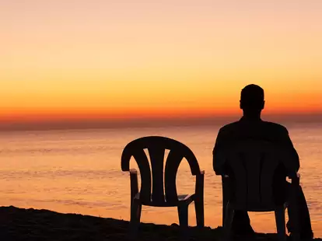
Is there a relationship between social media and loneliness for introvert and extrovert?

Slide 41
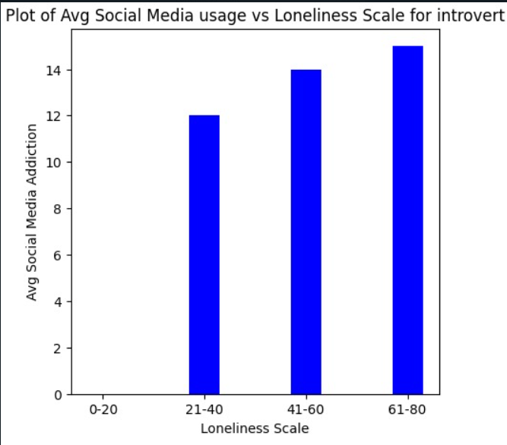
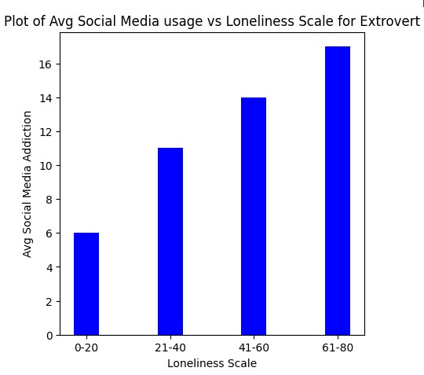
Social Media and Loneliness: Empirical Studies
Is social media providing a way to people to reduce their loneliness or it is the reason for people getting lonely?
For Introvert:
For Extrovert:

Slide 42



Slide 43

Do people preferences have impact on loneliness?
Free time preference
Enjoy on social media or talking to friends?
Prefer Online Friends or Offline Friends?

Slide 44


Free time preference
Students who prefer to use social media in their free time are found to be more addicted to social media as well as their loneliness level is also moderate.

Slide 45


What do You prefer: having fun on social media or conversing with friends?
Those who prefer having fun on social media against conversing with friends are found to be more lonely as well as they are more addicted to social media.
Students who prefer conversing with friends rather than using social media are found to be less addicted to social media as well as they are less lonely.

Slide 46


Prefer Online Friends or Offline Friends?
Students who prefer online friends are more lonely as well as they are more addicted to social media as compared to students who prefer offline friends.

Slide 47

How is individual’s Social relationship with others related to loneliness ?
% of online friends you know personally
How much support available on social media vs in person interactions?

Slide 48


Percentage of online friends you know personally
Those who know their social media friends personally rarely are found to be less addicted to social media but more lonely.
Those who know their social media friends personally moderately are found to be more addicted to social media and less lonely.

Slide 49


How much support available on social media vs in- person interactions?
Person having high support on social media is found to be less lonely as well as less addicted to social media.
Person addicted to social media having rare or less support available is found to be more lonely.

Slide 50

Effect of Covid-19 Pandemic on loneliness and Social Media Usage

Slide 51


Impact of covid-19
Those who think that their social media usage boosted during covid-19 are found to be more addicted to social media as well as they are more lonely.

Slide 52
Results, Limitations and Further Studies
Considering various factors such as demographic group, duration spent on social media, Student’s preferences, introvertedness and covid-19 impact, a scientific study on social media and loneliness is displayed.
From above discussion, a overall result can be concluded that social media has harsh impact on loneliness.
Limitations
Due to less amount of survey data available for some groups like 4th year whose loneliness scale is in between 61-80, we have to consider result as outliers in some cases.
Survey data available for IITs Engineering Students only.
Further Studies
This Survey can be further enhanced to other age groups and educational background and a further analysis on social media and loneliness can be carried out.
This Kind of survey may help WHO and National Institute of Health for carrying various initiative as they consider social connection as essential for our mental health and well-beings.

Slide 53
References
www.shutterstock.com
https://blocksurvey.io/calculator/bergen-social-media-addiction-scale#bsmas--how-it-works
https://www.forbes.com/sites/traversmark/2023/01/21/are-you-suffering-from-social-media-induced-loneliness/?sh=41e3021a1431
https://images.google.com/

Slide 54


Thanks!

